Slide 1

Introduction to AI(AI101B) Even Semester Session 2024-25
Sudoku Solver
Team Leader: Ridhi Rajput (2426MCA334)
Member: Sanket Pundhir(2426MCA503)
Member: Namrta Singh(2426MCA680)
Project Supervisor:
Ms. Komal Salgotra
Assistant Professor

Slide 2

Content
Introduction
Sustainable Development Goal
Objective of the Project
Methodology
Results
References
Notes:
Font Styles: Times New Roman + Font Size: 25

Slide 3
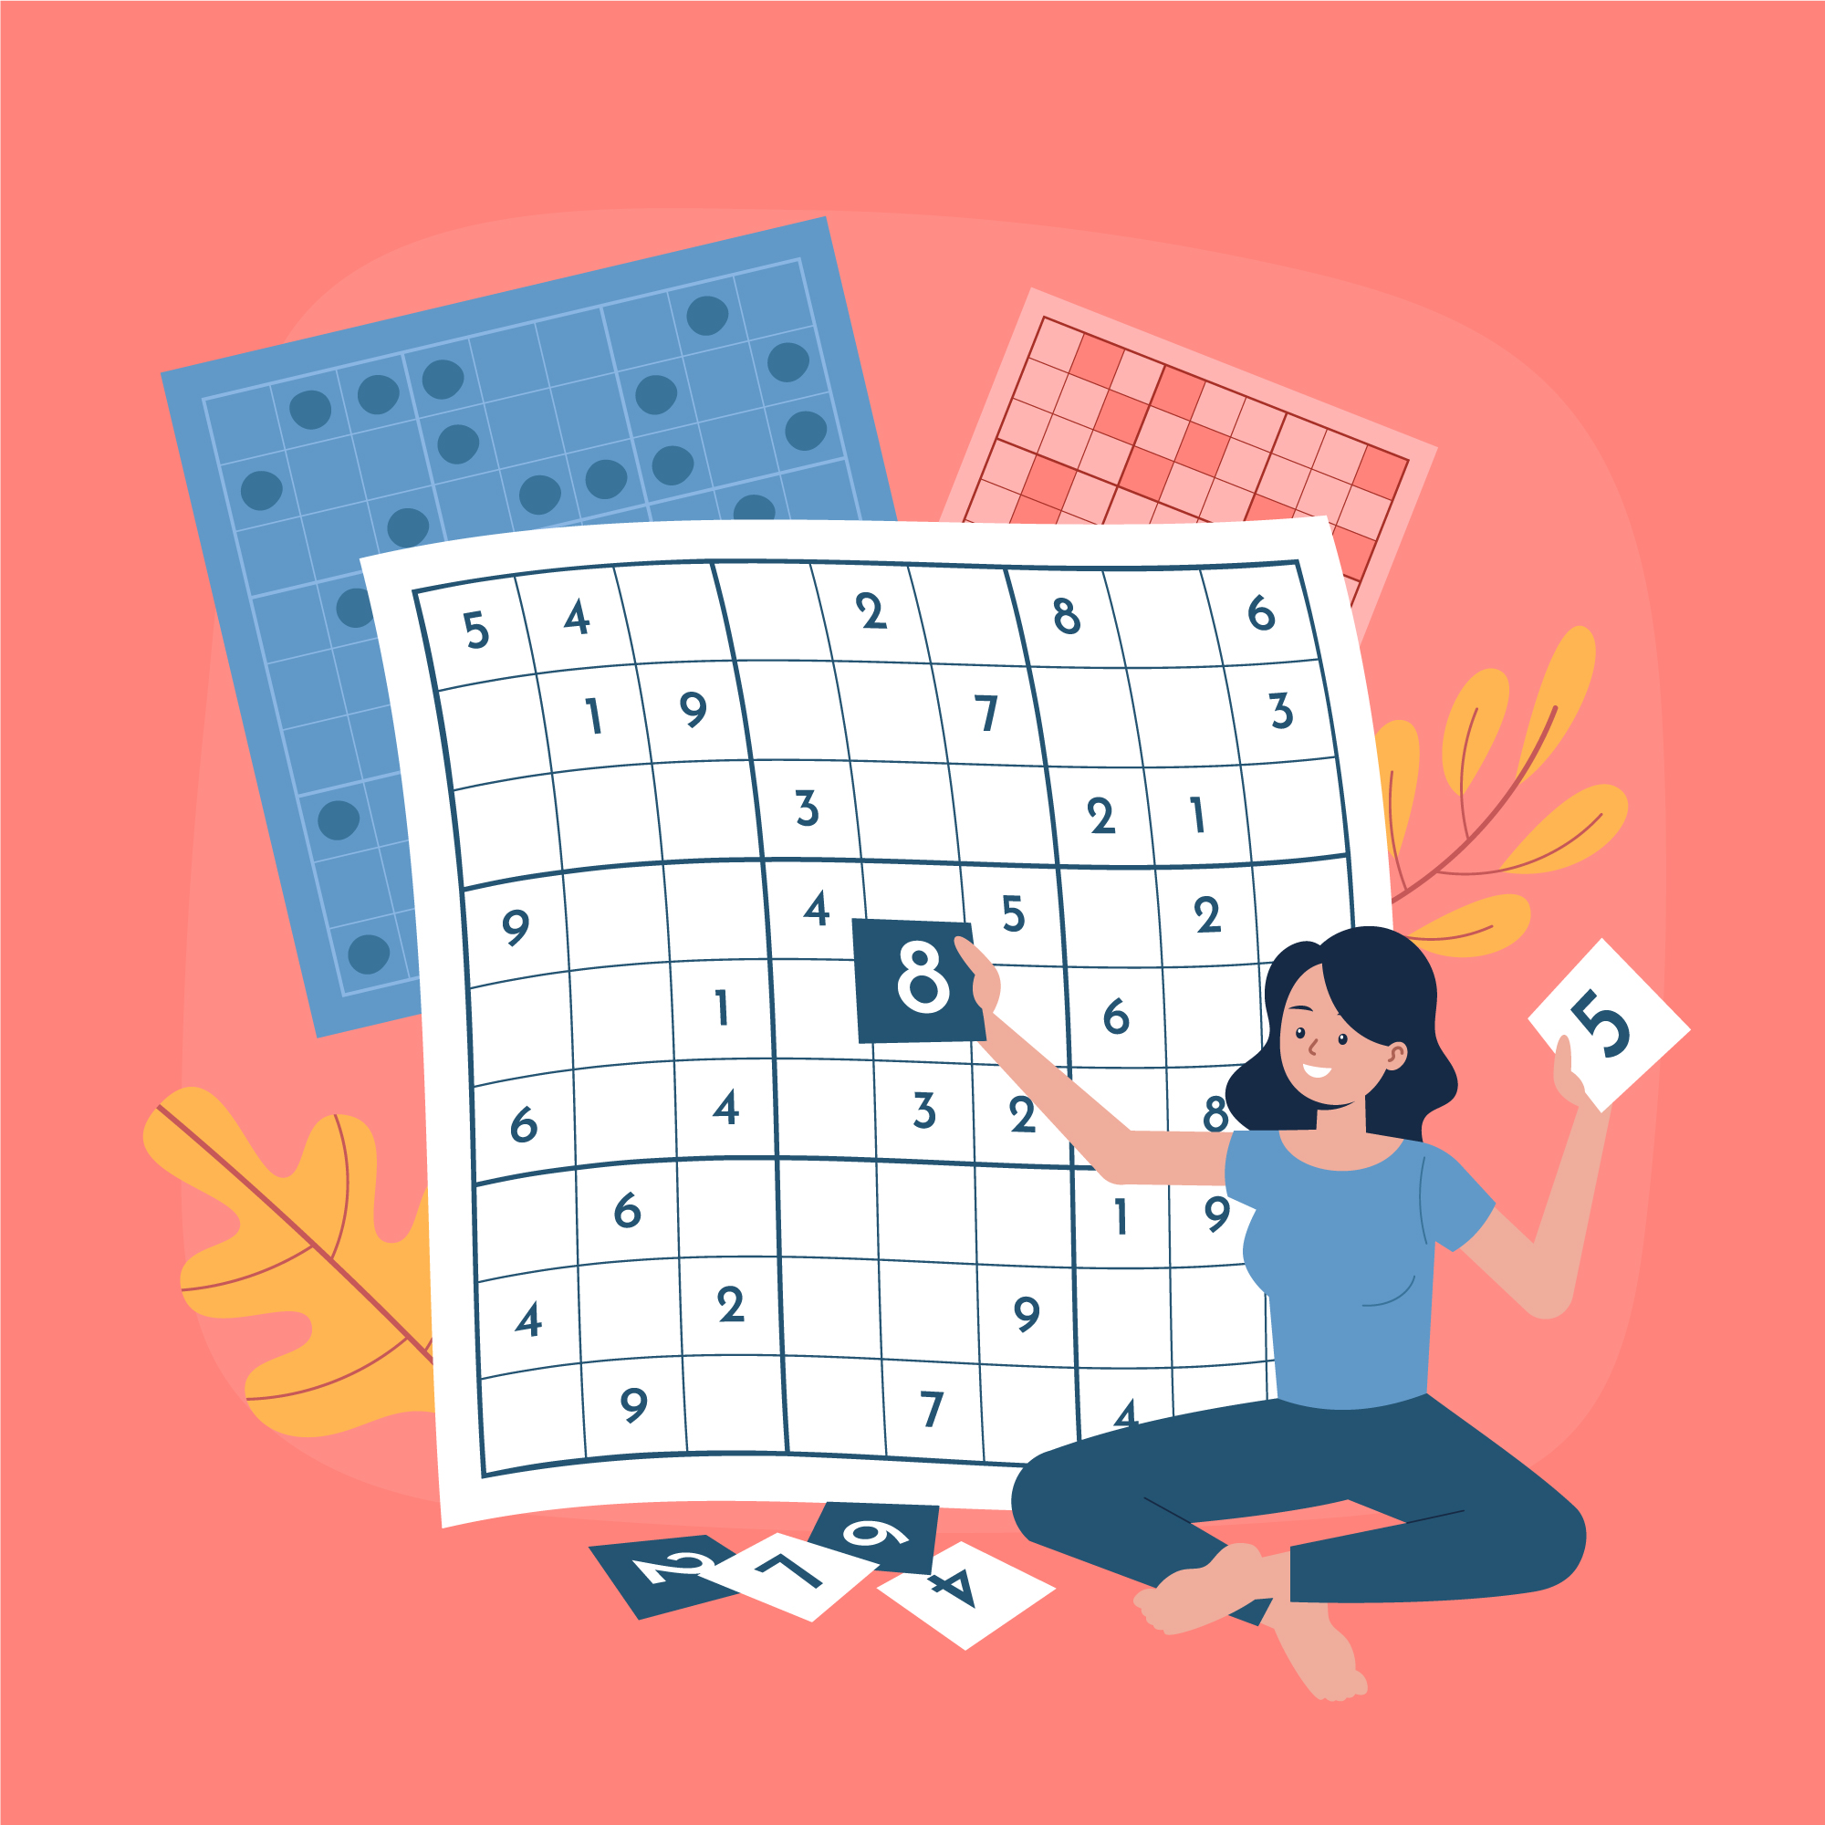
Introduction
Sudoku is a popular logic-based number puzzle that challenges players to fill a 9×9 grid with digits from 1 to 9 while following specific constraints. Our Sudoku Solver is a Python-based project designed to efficiently solve Sudoku puzzles using algorithmic techniques. This project leverages backtracking algorithms to find solutions quickly and accurately. It showcases the power of Python programming, recursion, and problem-solving strategies in artificial intelligence and computational mathematics. Our goal is to provide a tool that can solve even the most challenging Sudoku puzzles, demonstrating how programming can simplify complex logical problems.
Notes:
Font Styles: Times New Roman + Font Size: 25

Slide 4

Sustainable Development Goal
Our project will likely contribute to Sustainable Development Goal 4 (SDG 4): Quality Education.
How It Relates to SDG 4 (Quality Education)?
Enhances Problem-Solving Skills: Sudoku is a logical game that improves critical thinking and cognitive abilities.
Promotes Computational Thinking: The project applies algorithms and programming to solve real-world puzzles, helping in STEM education.
Encourages Learning Through Technology: Python-based projects like this provide hands-on learning opportunities for students and educators.

Slide 5
Objective of the Project
Automate Sudoku Solving
Develop a Python-based program that effectively solves Sudoku puzzles using algorithms
Enhance Logical Thinking
Demonstrate how programming can be applied to solve complex logical problems systematically.
User- Friendly Implementation
Improve Computational Efficiency
Create an intuitive interface (UI) for easy interaction with the solver.
Ensure the solver runs efficiently for different modes(manual or image)of Sudoku puzzles.
Notes:
Font Styles: Times New Roman + Font Size: 25

Slide 6
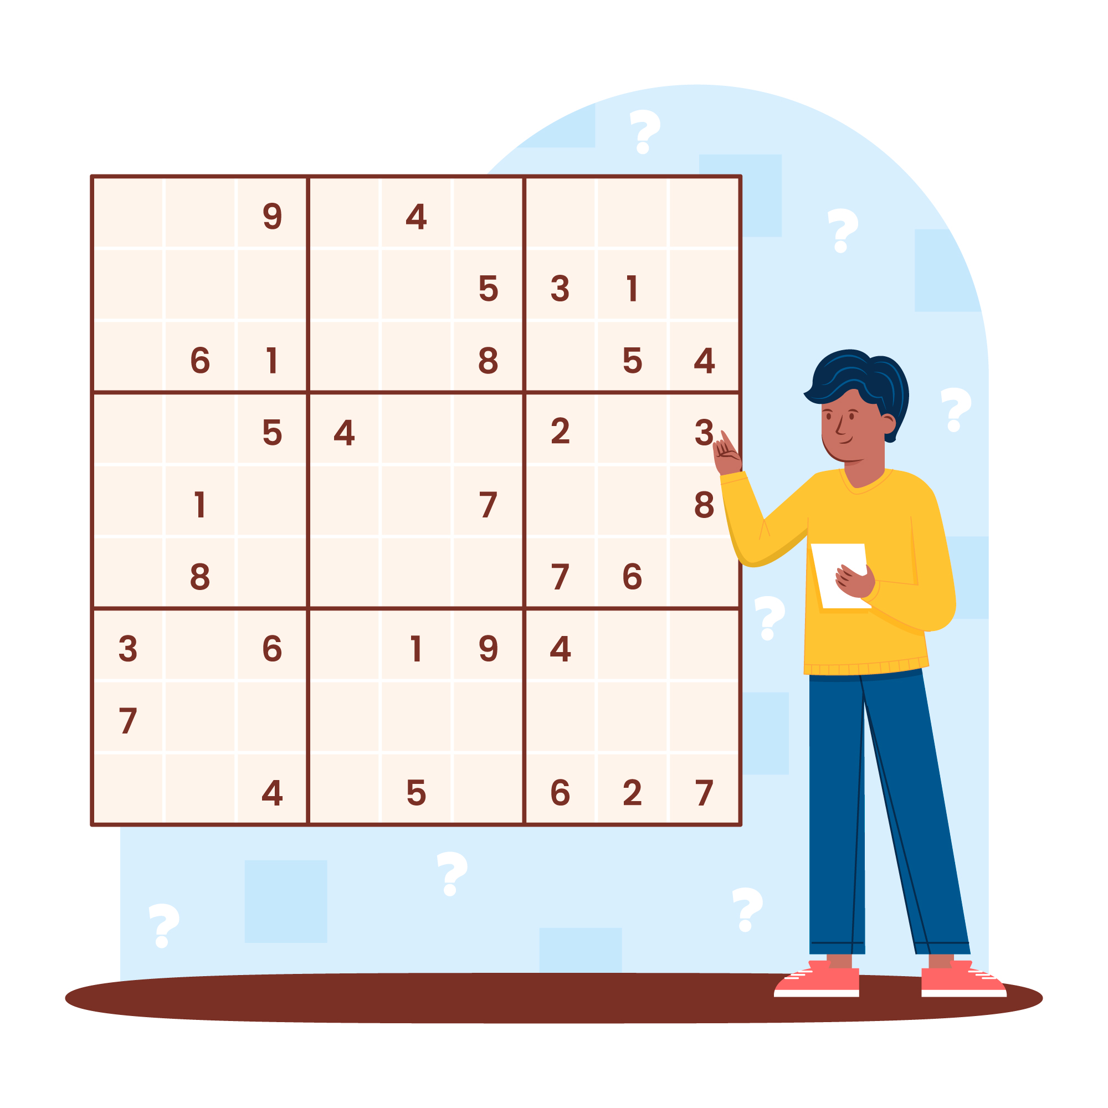
Methodology
1. Problem Understanding & Research
Studied the rules and constraints of Sudoku.
Researched existing Sudoku-solving techniques and algorithms.
2. Algorithm Selection
Chose the Backtracking Algorithm for solving Sudoku due to its efficiency.
3. Implementation Using Python
Designed a grid representation for the Sudoku board.
Implemented the backtracking algorithm to fill empty cells following Sudoku rules.
Ensured input validation to check for valid Sudoku puzzles.

Slide 7
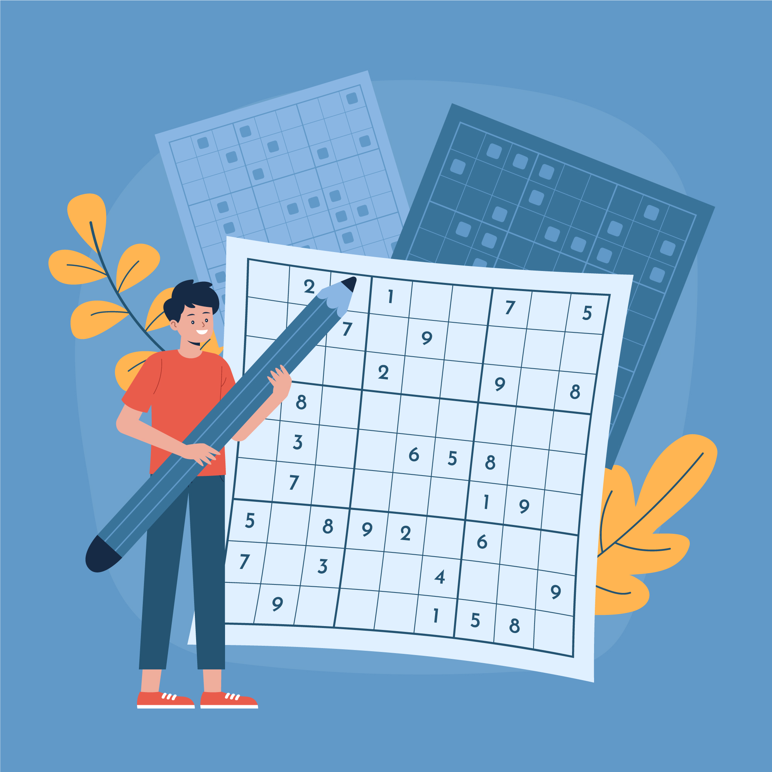
Methodology
4. Testing & Debugging
Tested the solver with various Sudoku input methods (manual and by image).
Identified and fixed logical errors to improve accuracy.
5. Optimization & Efficiency Enhancement
Enhanced the algorithm to reduce unnecessary computations.
Improved execution speed for solving large and complex Sudoku puzzles.
6. User Interface
Designed a simple UI (dropdown, buttons, file upload) for user interaction.
Allowed users to input puzzles and view solutions in a structured format.

Slide 8
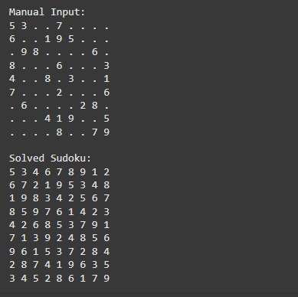
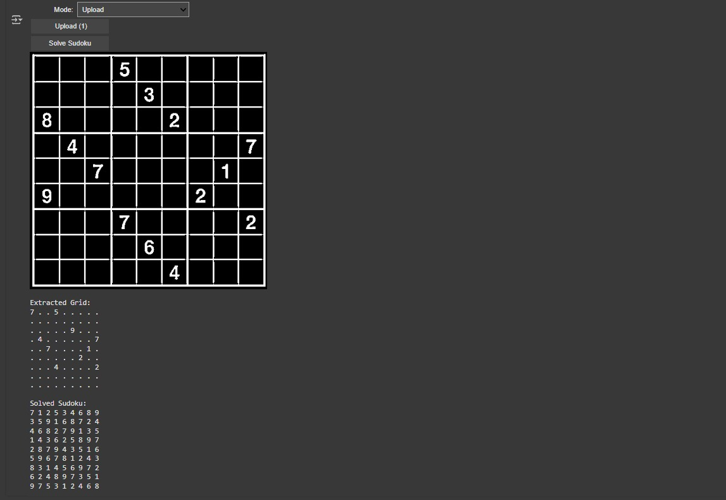
Results
Manual Input
Image Input
Notes:
Font Styles: Times New Roman + Font Size: 25

Slide 9
References
Sudoku.com- The rules of Sudoku
Github.com- Sudoku Solver in Python
GeeksforGeeks.com- Backtracking Algorithm Explained
W3Schools.com- Python Backtracking Examples

Slide 10

THANK YOU!

